Slide 1
Diary Management System
Team 1
Solomon Henry, Cayleigh Goberman, Jakeline Linares, Cheryl Kumah, Erick Perez

Slide 2
Table of contents
01
02
03
04
Team Description
System Description
Entity Relationship Models
Enhanced Entity Relationship Model
05
06
07
08
SQL Database Development
Loading Data and Performance Enhancements
Graphical User Interface
References
2

Slide 3
01
Our Team
3

Slide 4

Meet the Team
4
* Solomon Henry *
* Team Leader *
2nd year Junior
Computer Science Major
Software Development Concentration
Cayleigh Goberman
Sophomore from Connecticut
Computer Science Major
Cheryl Kumah
Senior at Marist College
Marketing Major
Information Systems Minor
Erick Perez
Sophomore from the Bronx
Cybersecurity Major
Jakeline Linares
Junior Transfer
Computer Science Major

Slide 5
02
System Description
5

Slide 6
Our System
6
A Diary Management System that allows different users to record daily events and experiences. Including the ability to add and update records.
It also has the additional functionality of acting as a planner, being able to record tasks for the user to complete

Slide 7
Goals
Account Creation
Separation of Admin and User
01
03
Entry Creation
Fluid Interaction
02
04
7
Enable our users and admins to create secure accounts
Provide different services to admins and users
Allow our users to search for, create, edit, and delete their own entries within their own diaries & planners
Provide a positive interaction to our users

Slide 8
03
Entity Relationship Models
8

Slide 9
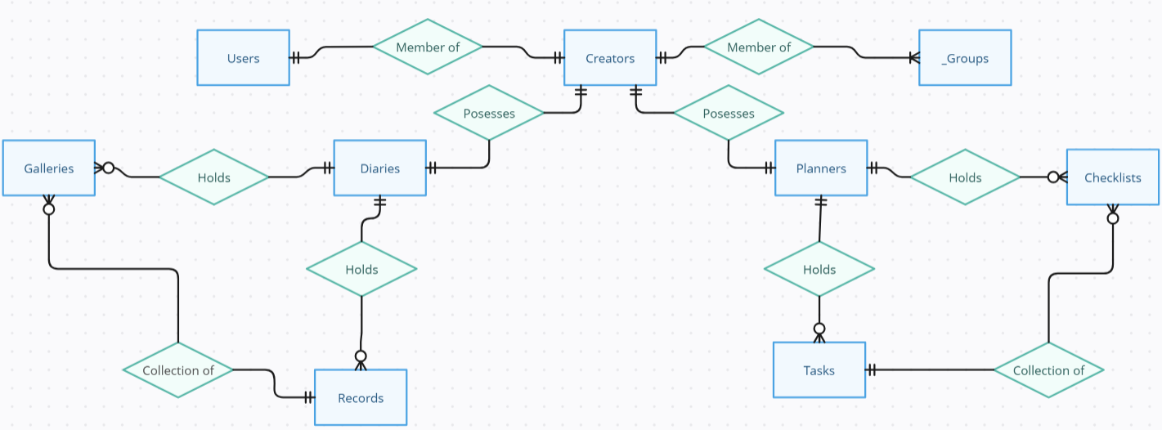
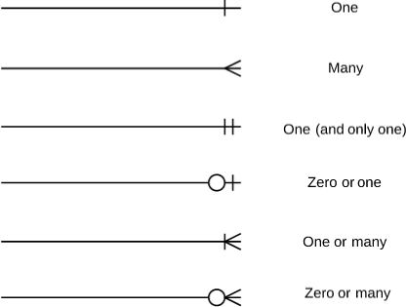
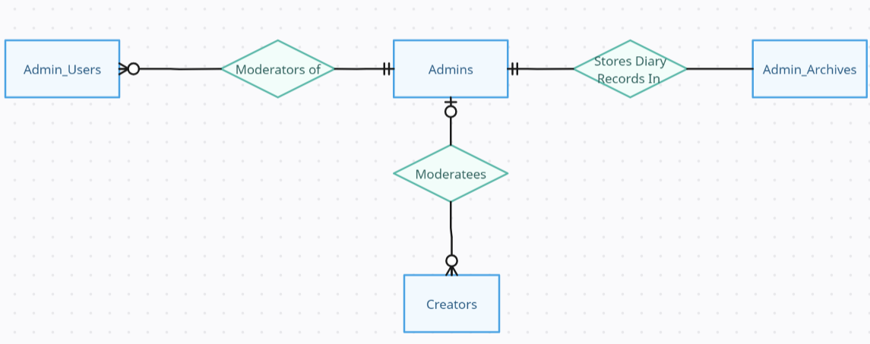
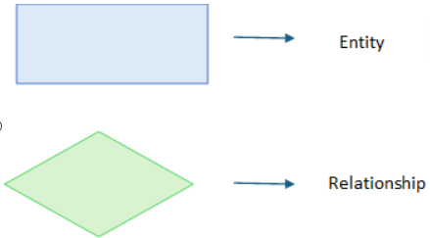
External Models
9
User
Admin

Slide 10
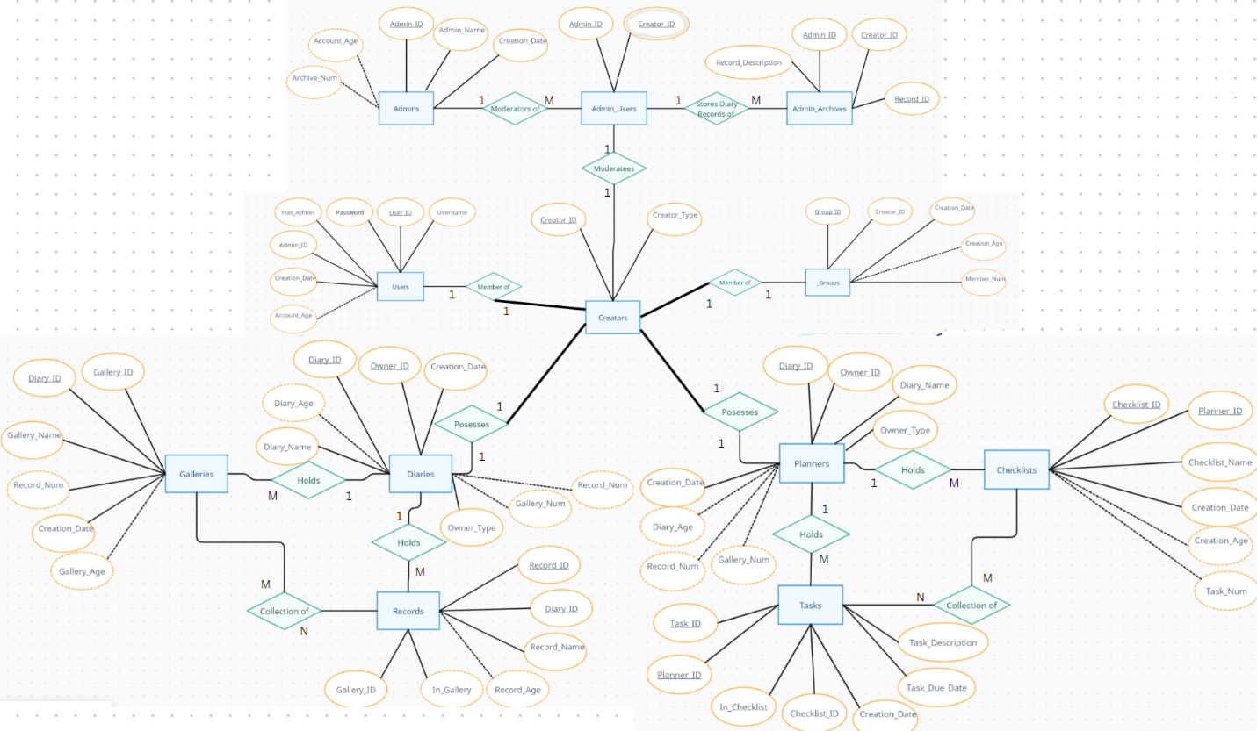
Conceptual Model
10

Slide 11
04
Enhanced Entity Relationship Model
11

Slide 12
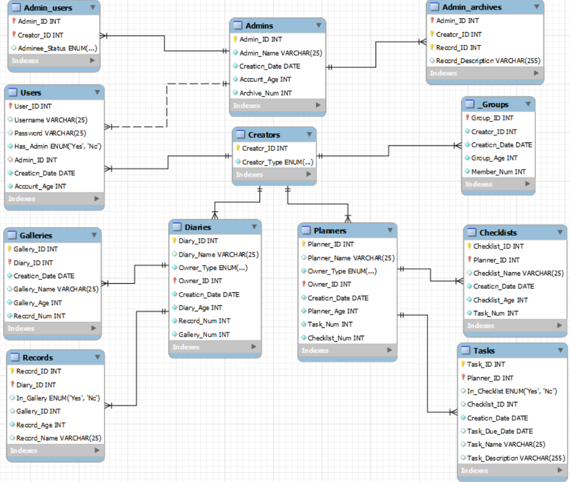
EER Model
12

Slide 13
05
SQL Database Development
13

Slide 14

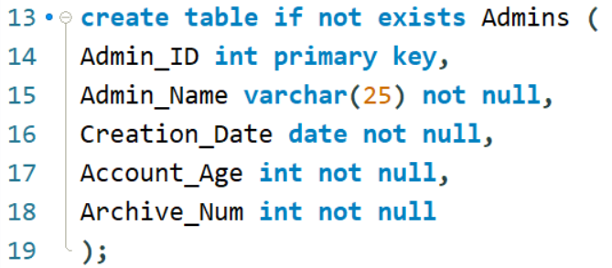
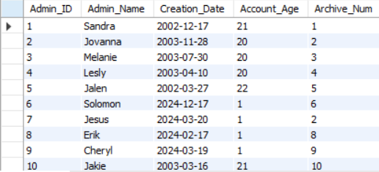
SQL Database Development
14
Database was created and named diary_management
Tables were created based off the EERD

Slide 15
Normalization
17
First Normal Form:
Every table has a primary key
Every value is single-valued
Second Normal Form:
Meets the criteria of the 1NF
Any data that is not a key relies on the PK.
Third Normal Form:
Meets the criteria of 1NF and 2NF
There are no transitive dependencies between non-key attributes
Notes:
This message is an example of an error code we came across while attempting to insert the values into the Admin_Archives table. Since Admin_Archives has a foreign key that references the Admin_ID in the Admins table, the Admin_IDs in both tables had to match. However, this issue can be temporarily resolved while inserting the data by utilizing the command
SET FOREIGN_KEY_CHECKS = 0;.
This is a problem that was encountered while creating the individual tables. Once every table is created and functions correctly, we can re-enable foreign key checks by using
SET FOREIGN_KEY_CHECKS = 1;

Slide 16
06
Loading Data and Performance Enhancements
15

Slide 17
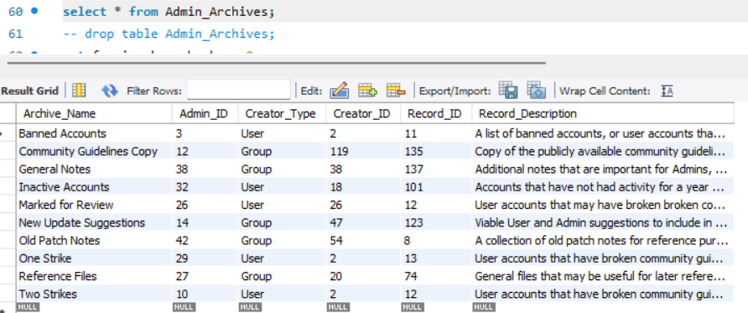
Handling Foreign Key Constraints
17
Problem: Insertion error due to a failed foreign key constraint
Solution:
SET FOREIGN_KEY_CHECKS = 0; .
Notes:
This message is an example of an error code we came across while attempting to insert the values into the Admin_Archives table. Since Admin_Archives has a foreign key that references the Admin_ID in the Admins table, the Admin_IDs in both tables had to match. However, this issue can be temporarily resolved while inserting the data by utilizing the command
SET FOREIGN_KEY_CHECKS = 0;.
This is a problem that was encountered while creating the individual tables. Once every table is created and functions correctly, we can re-enable foreign key checks by using
SET FOREIGN_KEY_CHECKS = 1;

Slide 18
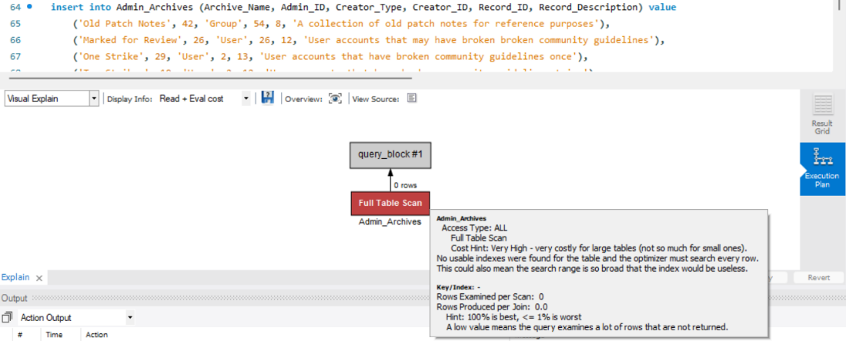
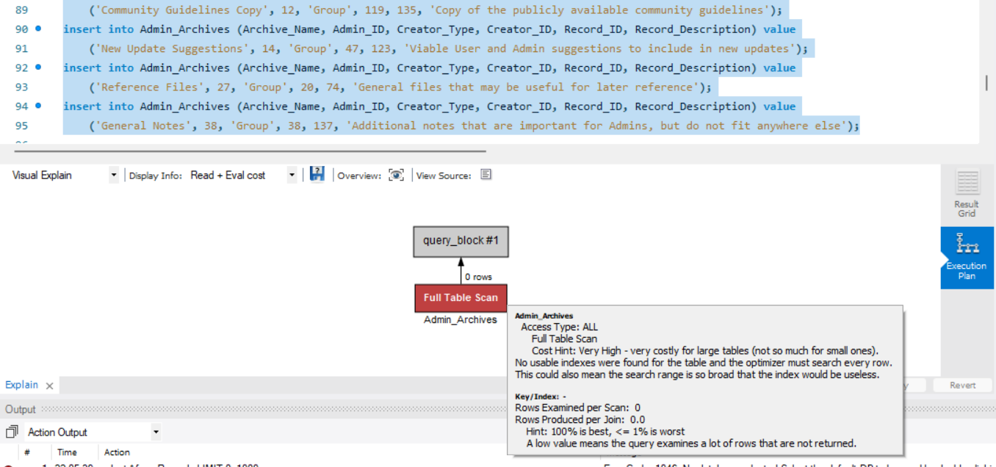
Insertion Optimization
18
Single Statement Multiple Statements
Notes:
The data usage for both the single statement and multiple insert statements appears to be to be high. On one hand, it can be simpler to write out the single insert statement, as there are less chances for syntax errors. However, each individual, smaller insert statement probably utilizes less processing power for each one; they only become cumbersome when multiple are utilized at the same time. As such, it would most likely be more efficient to write a single insert statement for when numerous instances need to be inserted into the table, and multiple insert statements when only a few instances are required.

Slide 19
07
Graphical User Interface
19

Slide 20
References
(Employed Over the Course of the Project)
20
[1] https://www.scheduleit.com/diary-software.htm
[2] https://www.adobe.com/express/create/online-journal
[3] https://dayoneapp.com
[4] https://www.sqltutorial.org/sql-data-types/
[5] https://dev.mysql.com/doc/refman/8.0/en/string-type-syntax.html
[6] https://dev.mysql.com/doc/refman/8.0/en/char.html
[7] https://dev.mysql.com/doc/refman/8.0/en/binary-varbinary.html
[8] https://dev.mysql.com/doc/refman/8.0/en/blob.html
[9] https://dev.mysql.com/doc/refman/8.0/en/enum.html
[10] https://dev.mysql.com/doc/refman/8.0/en/set.html
[11] https://amplitude.com/blog/data-types
[12] https://dev.mysql.com/doc/refman/8.0/en/data-type-defaults.html

